Slide 1

PITCH FOR FUNDING

Slide 2
AGENDA
1.COMPANY OVERVIEW
2.COMPANY AIM
3.WHERE COMPANY STAND IN NUMBERS
4.OVERALL GROWTH OF COMPANY SINCE IT’S INCEPTION
5.AREA WHERE SUPPORT NEEDED
6.FUTURE ACTIONS
7.STRATEGIC FOCUS AREAS

Slide 3
COMPANY OVERVIEW
It is a soft toy selling e-commerce company which has launched four products (that are The Original Mr. Fuzzy,The Forever Love Bear,The Birthday Sugar Panda,The Hudson River Mini bear) so far and sells them through its website.
Launched in March 2012
Region : USA

Slide 4
COMPANY AIM
The company aims to leading global brand in the stuffed toys market by continuously innovating and expanding our product line to meet the evolving needs and preferences of customers.

Slide 5
WHERE COMPANY STAND IN NUMBER’S

Slide 6
WHERE COMPANY STAND IN NUMBERS
Total Sessions | 472.87 K
Total Repeat Sessions | 78.55 K
Total Orders | 32.31 K
Best Selling Product | The Original Mr. Fuzzy
Total Pageviews | 11.88 L
Total Profit | $ 1.21 M

Slide 7
WHERE COMPANY STAND IN NUMBERS
Total Revenue | $ 1.94 M
New Customers | 31.11 K
Repeat Customers | 0.59 K
Best Selling Platform | G-Search

Slide 8
OVERALL GROWTH OF COMPANY SINCE IT’S INCEPTION

Slide 9
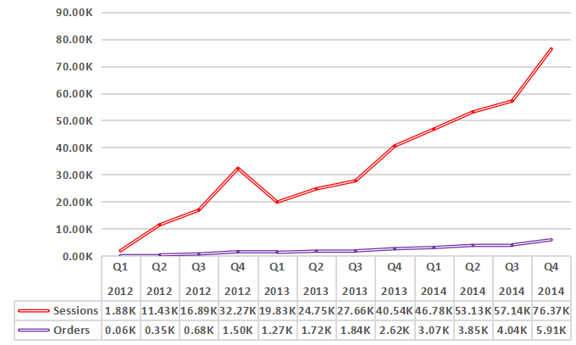
GROWTH OF BUSINESS BY VOLUME
From early 2012 to late 2014, we saw significant growth in both website sessions and orders. Sessions and orders notably increased each Q4, highlighting a strong end-of-year boost in activity.

Slide 10
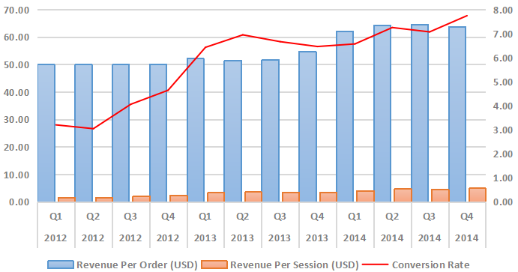
SESSION TO ORDER CONVERSION RATE
Between Q1 2012 and Q4 2014,
Revenue Per Order increased from $49.99 to $63.79, showing that customers are spending more per order.
Revenue Per Session grew from $1.60 to $4.93, indicating better monetization of website traffic.
Conversion Rate improved from 3.19% to 7.74%.

Slide 11
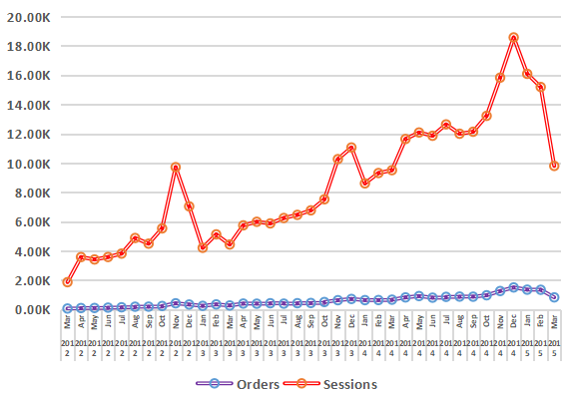
GROWTH FROM G-SEARCH
Order Growth increased from 0.06k in March 2012 to 1.35K in January 2015.
Session Growth rise from 1.86K in March 2012 to 16.09K in January 2015.
Seasonal Patterns notable spikes in orders & sessions during November and December each year.

Slide 12
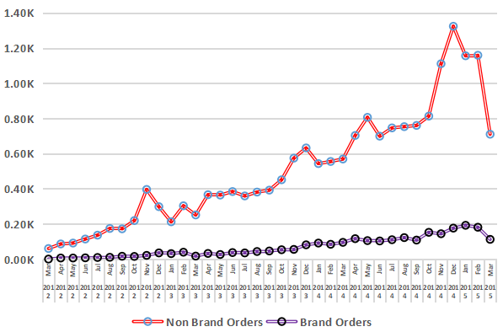
G-SEARCH GROWTH FROM BRAND & NON BRAND
Non-Brand Orders saw significant growth from 0.06K in March 2012 to 1.16K in January 2015.
Brand Orders increased slowly from near zero to 0.19K over the same period.
Seasonal Trends both order types peaked in November and December each year.

Slide 13
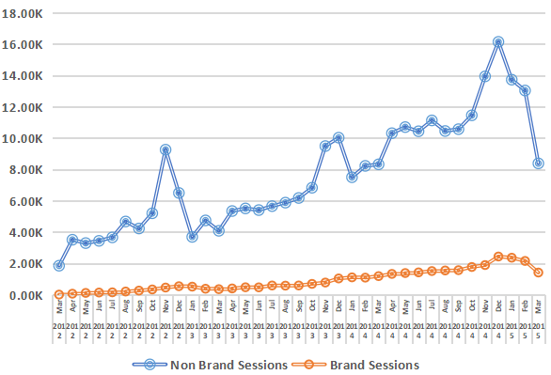
G-SEARCH GROWTH FROM BRAND & NON BRAND
Non-Brand Sessions rise from 1.85K in March 2012 to 13.73K in January 2015.
Brand Sessions increased from 0.01K to 2.36K over the same period.
Seasonal Trends both session types peaked in December each year.

Slide 14
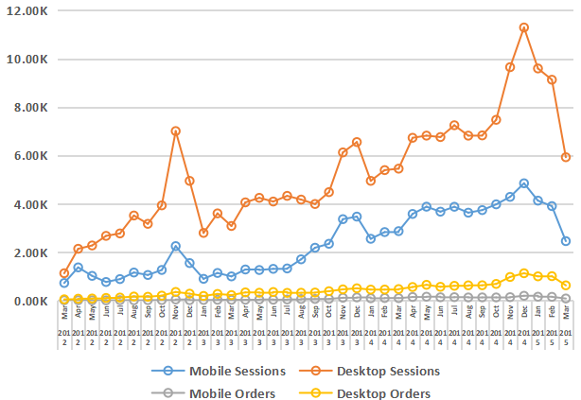
DEVICE TYPE GROWTH FOR G-SEARCH
Growth Trends both mobile and desktop sessions and orders grew a lot over time.
Desktop Dominance desktop sessions and orders were consistently higher than mobile ones.
Seasonal Peaks both mobile and desktop sessions and orders were highest in December each year.

Slide 15
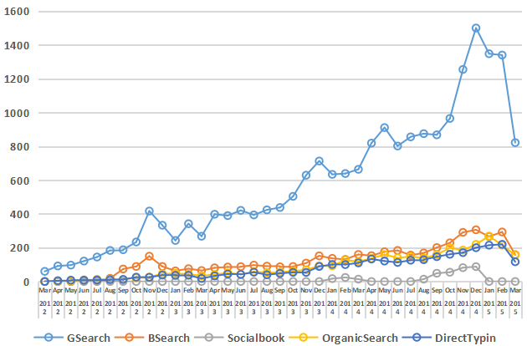
CHANNEL WISE GROWTH FOR ORDERS
Google Search consistently saw the highest numbers, indicating it was the most effective channel.
Bing Search and Socialbook also showed growth but were smaller in comparison.
Direct Typing and Organic Search had noticeable increases, showing rising direct and organic traffic.

Slide 16
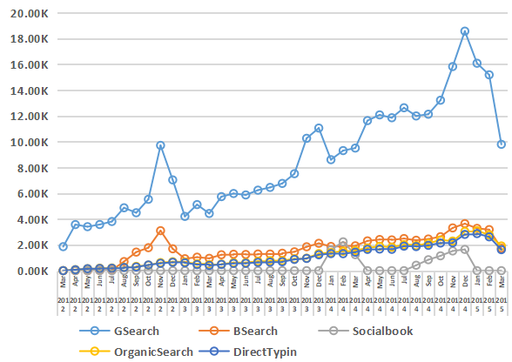
CHANNEL WISE GROWTH FOR SESSIONS
Google Search was the dominant traffic source and saw the most significant growth.
Bing Search and Socialbook showed consistent increases, with notable peaks.
Organic Search and Direct Typing also grew steadily, with peaks in December.

Slide 17
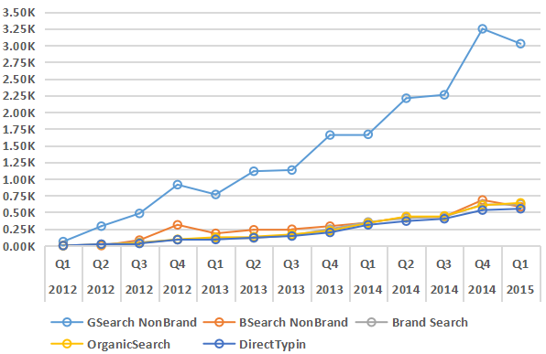
CHANNEL & CAMPAIGN WISE ORDER GROWTH
Google Search Non-Brand experienced the most significant growth, becoming the top source of orders.
Brand Search and Organic Search also saw consistent increases, contributing to overall growth.
Bing Search Non-Brand and Direct Typing showed steady growth, with notable increases in recent quarters.

Slide 18
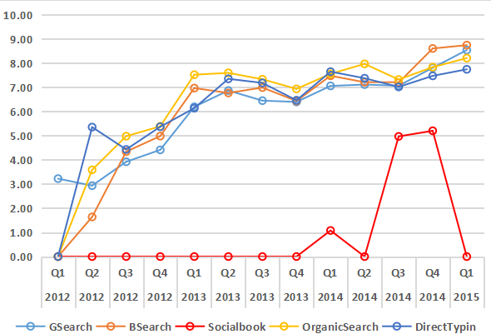
CHANNEL WISE COVERSION RATE
Google Search and Organic Search grew steadily, becoming dependable ways for people to find us.
Bing Search increased a lot, especially in the later months.
Socialbook started bringing in more traffic towards the end of the time period.
Direct Typing kept growing, showing that people are directly typing our website into their browsers regularly.

Slide 19
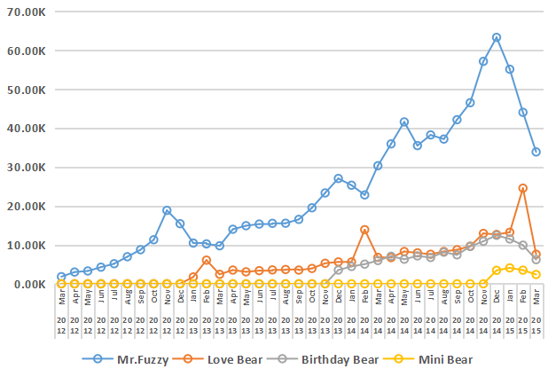
MARGIN GENERATED BY PRODUCTS
Mr. Fuzzy consistently made more money over time, with the highest profits in late 2014 and early 2015.
Love Bear started making more money in early 2013, with a big boost in February 2015.
Birthday Bear began making more money towards the end of 2013, and kept growing through 2014 and 2015.

Slide 20
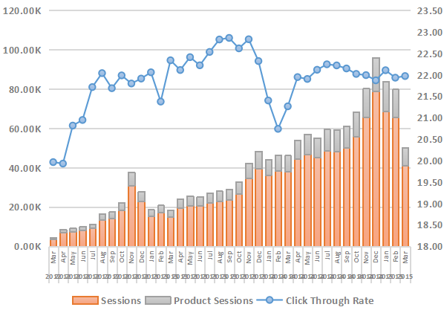
CLICK THROUGH RATE FOR /PRODUCT
Click Through Rate (CTR): Generally increased over time, reaching its highest in late 2013 and staying high through early 2015.

Slide 21
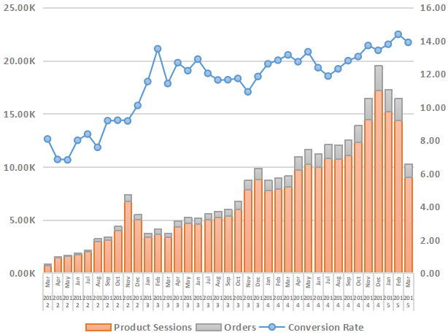
CONVERSION RATE FOR /PRODUCT PAGE
Conversion Rate Improvement: The rate generally increased over time, reaching its highest point in early 2015.
Early Peaks: Highest rates were in late 2012 and early 2013.
Strong Finish: The rate peaked at 14.39% in February 2015, showing strong performance towards the end of the period.

Slide 22
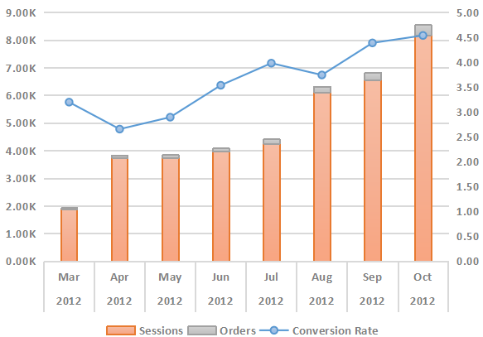
CONVERSION RATE FOR INITIAL 8 MONTHS
From March to October 2012, the conversion rate steadily increased, showing improved effectiveness in converting visitors into buyers. Both the number of sessions and orders grew each month, peaking in October, indicating that increased traffic was leading to more purchases.

Slide 23
FOR YEAR 2012 G-SEARCH NON-BRAND TEST
Time Period | Jun19-Jul28 | May10-Jun18
Sessions | 4.57K | 4.28K
Orders | 0.16K | 0.13K
Conversion Rate | 3.63 | 3.10
Revenue (USD) | 8.29K | 6.64K
we can clearly see that the coverasion rate is increased by 0.53 which represent that the overall business is growing as compare to the previous month.

Slide 24
FOR YEAR 2012 HOME PAGEURL
Time Period | Jun19-Jul28 | May10-Jun18
Sessions | 2.99K | 4.88K
Orders | 0.11K | 0.16K
Conversion Rate | 3.81 | 3.20
we can clearly see that the coverasion rate is increased by 0.61 which represent that the overall homepage url is growing as compare to the previous month.

Slide 25
FOR YEAR 2012 LANDER-01 PAGEURL
Time Period | Jun19-Jul28 | May10-Jun18
Sessions | 2.32K | 0.00
Orders | 0.09K | 0.00
Conversion Rate | 4.60 | 0.00
we can clearly see that the all the metrics for lander-1 page (May10-Jun18) is zero , which means that the lander-1 is intoduced by the company in 19-Jun-2012 .

Slide 26
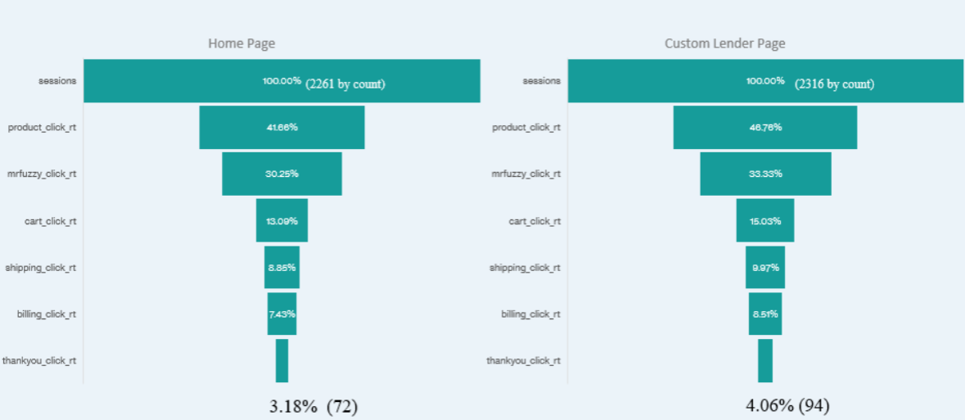
CONVERSION FUNNEL
This analysis of landing page performance (June 19 - July 28), we tracked user behavior from initial visit through to order completion of two landing page.

Slide 27
CONVERSION FUNNEL
Effective Funnel Progression: High click-through rates to product pages and smooth movement through cart, shipping, and billing.
Successful Conversions: High conversion rates on the Thank You page, especially from Lander-1.
Key Insight: Lander-1 shows superior performance and is crucial for optimization.

Slide 28
FOR YEAR 2012 BILLING PAGEURL
Time Period | Sep10-Nov10 | Jul10-Sep09
Sessions | 0.66K | 0.93K
Revenue(USD) | 15.00K | 21.20K
Revenue Per Billing Session (USD) | 22.83 | 22.84
we can clearly see that the all the metrics for /billing page is decreasing with the gradually increasing in the time.

Slide 29
FOR YEAR 2012 BILLING-02 PAGEURL
Time Period | Sep10-Nov10 | Jul10-Sep09
Sessions | 0.65K | 0.00
Revenue(USD) | 20.50K | 0.00
Revenue Per Billing Session (USD) | 31.34 | 0.00
Together, both Billing and Billing-2 pages are achieving great growth. According to this, we can say that overall business has grown by introducing new billing-2 page.

Slide 30
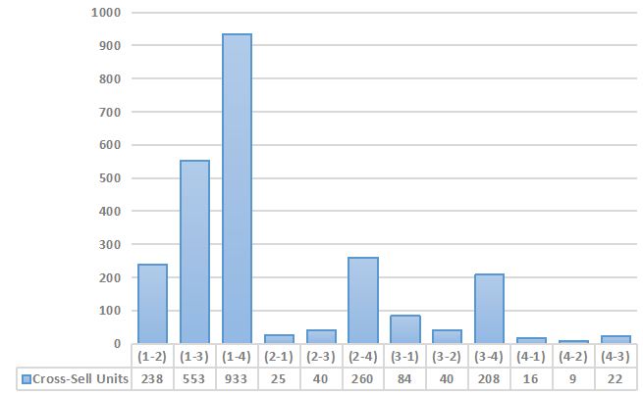
CROSS-SELLING OF PRODUCTS

Slide 31
CROSS-SELLING OF PRODUCTS
Product 1:
Strongly cross-sells with Products 3 and 4.
High tendency for Products 1, 3, and 4 to be bought together.
Product 2:
Notably cross-sells with Product 4.
Minimal cross-sell with Product 1, suggesting potential for targeted bundling.
Product 3:
Strongly cross-sells with Product 4.
Less emphasis on cross-sell with Product 2.
Product 4:
Shows potential for higher performance when cross-sold with Products 1 and 3.
Cross-sold the least overall, indicating opportunities for improvement

Slide 32
AREAS WHERE SUPPORT IS NEEDED

Slide 33
IMPROVEMENTS
Enhance Mr. Fuzzy: Continue investing in marketing and new features, and consider launching similar products to leverage its success.
Evaluate Mini Bear: Review performance and customer feedback to decide if it should be redesigned or discontinued.
Optimize Advertising: Invest more in successful non-brand campaigns and Google Search promotions to boost visibility and conversions.
Improve Mobile Experience: Optimize the website for mobile to increase usability and order placement.
Bundle Products: Create product bundles and promotions to encourage cross-sales, especially combining successful products like Mr. Fuzzy.
Invest in Innovation: Continue developing new products and features to stay ahead of competitors.

Slide 34
FUTURE ACTIONS

Slide 35
Product Development and Expansion
Expand Product Line: Introduce new products similar to Mr. Fuzzy.
Enhance Existing Products: Improve features and quality based on feedback and trends.
Marketing and Branding
Increase Marketing Budget: Invest more in non-brand campaigns and Google Search promotions.
Launch Special Editions: Create limited-time or seasonal editions of popular products.
Digital and Mobile Optimization
Revamp Website and Mobile Experience: Enhance mobile usability and overall user experience.
Implement Advanced Analytics: Use data analytics tools to refine marketing and product strategies.

Slide 36
Customer Engagement and Loyalty
Develop Loyalty Programs: Launch programs offering rewards, discounts, and exclusive access.
Enhance Customer Support: Train staff and implement advanced CRM systems for better service.
Market Expansion
Explore New Markets: Research and enter new geographical markets with tailored strategies.
Build Strategic Partnerships: Partner with local distributors, influencers, or retailers.
Operational Efficiency
Upgrade Technology and Infrastructure: Modernize technology and infrastructure for better efficiency.
Optimize Supply Chain: Improve supply chain management to reduce costs and enhance delivery.

Slide 37
STRATEGIC FOCUS
AREAS

Slide 38
Estimated Investment: $1Millions
1. Product Development and Expansion: $300K
New Product Development: $150K
Research and development
Prototype creation
Market testing
Enhancing Existing Products: $150K
Product feature improvements
Quality upgrades
Customer feedback implementation
2. Marketing and Branding: $250K
Increase Marketing Budget: $150K
Google Search promotions
Targeted digital advertising

Slide 39
Launch Special Editions: $100K
Design and production of limited-time or seasonal editions
Marketing and promotional activities
3. Digital and Mobile Optimization: $200K
Revamp Website and Mobile Experience: $120K
Website redesign
Mobile optimization
Implement Advanced Analytics: $80K
Data analytics tools and software
Hiring data analysts or consultants
4. Customer Engagement and Loyalty: $150K
Develop Loyalty Programs: $90K
Program design and implementation
Marketing and communication

Slide 40
Market Expansion: $60K
Explore New Markets:
Market research
Entry strategies
Localization of products and marketing

Slide 41
EXPECTED OUTCOMES FROM INVESMENT

Slide 42
Expected Outcomes
Revenue Growth from New Products: 15% increase in revenue from new product introductions.
Customer Satisfaction from Enhanced Products: 10% improvement in customer satisfaction and reduced churn due to product enhancements.
Brand Awareness: 20% increase in brand visibility and awareness.
Lead Generation and Conversion Rates: 15% improvement in lead generation and conversion rates from increased marketing efforts.
Sales Boost from Special Editions: 10% increase in sales due to limited-time offers and special editions.
User Engagement: 25% improvement in user engagement metrics (e.g., lower bounce rates, longer session durations).
Conversion Rates: 15% increase in conversion rates due to optimized digital experiences.

Slide 43
Expected Outcomes
Data-Driven Decisions: 10% improvement in marketing ROI due to better targeting and insights.
Customer Retention: 20% improvement in customer retention rates due to effective loyalty programs.
Revenue from New Markets: 10% increase in revenue from expanded market presence.

Slide 44
THANKYOU FOR LISTENING

